Slide 1

The Scrum-Agile Approach
Cha Yang

Slide 2
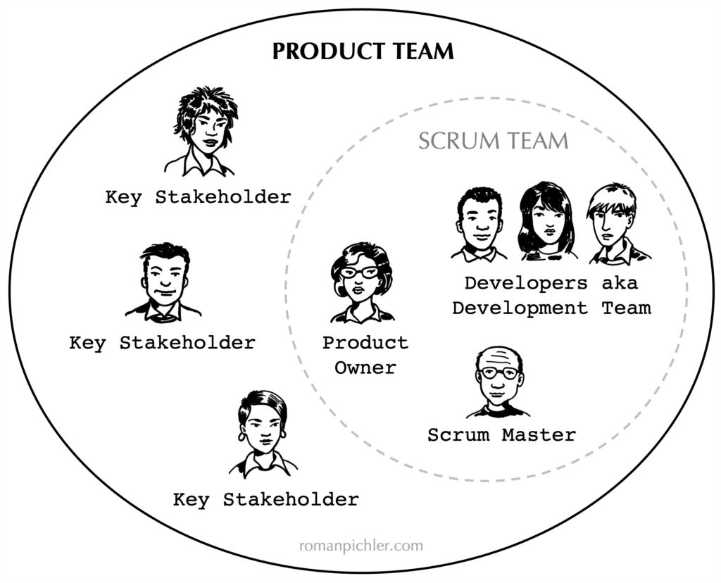
Various roles on a Scrum-agile team
Product Owner
Its role is to communicate and understand the requirements given by the key stakeholders. Responsible for the project’s outcome.
Scrum Master
Its role is to guide the development team throughout the project development through meetings and communications with the product owner and development team.
Development Team
Its role is to develop the requirements for the project and test the product throughout development
Notes:
The scrum team consists of the product owner, scrum master, and the development team. The product owner is essentially the face of the team and is responsible for the project’s outcome. The scrum master helps guide the development team and communicates with the product owner and development team as to what needs improvement. The development team is responsible for the development of the project and any test it needs to be ready for deployment.

Slide 3
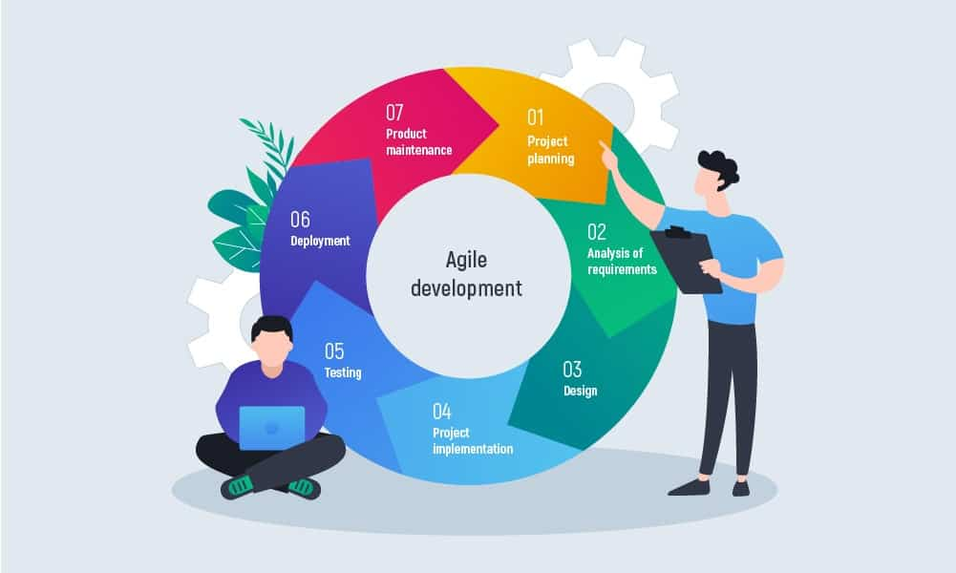
Various phases of SDLC in an agile approach
Agile in SDLC approaches software development with a continuous improvement approach.
Its different phases aims to improve upon each phase every coming round.
Development does not end with maintenance and continues to improve upon each phase as it undergoes new project planning and requirements
Notes:
Agile in SDLC approaches continuous improvement. Unlike the waterfall method, Agile can improve upon its phases in development even with new changes or requirements to the project. As each phase aims to improve upon the other, Agile is the most efficient for projects with changes and new requirements.

Slide 4
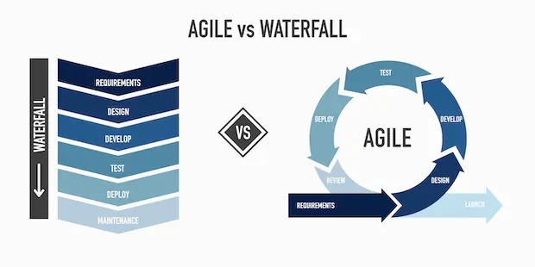
The waterfall method compared to agile
Unlike agile, the waterfall method approaches software development with a linear approach that aims to complete the project in steps, but no way to come around to improve again on each step.
The project would essentially end after deployment and undergoes common maintenance.
Efficient for projects with little requirements as it helps to decrease the time for project deployment and costs.
Notes:
The waterfall method is a more linear approach to software development. The project would end at the deployment stage and is built for projects with less requirements as there is no way to come around and continuously improve on each phase of the project after it is deployed.

Slide 5
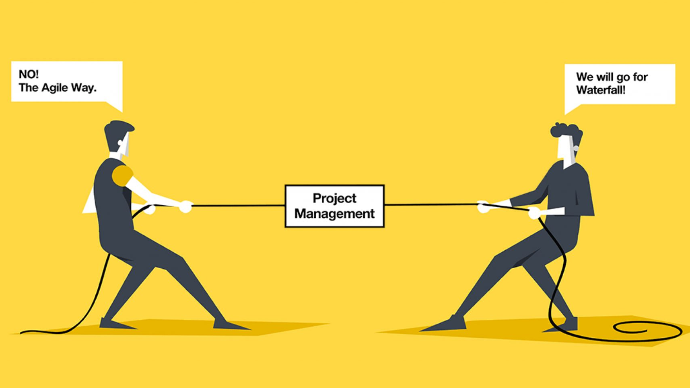
Factors in choosing a waterfall or agile approach
The waterfall and agile approach both have its uses. In certain circumstances, one can even be more efficient than the other.
Projects with less requirements, changes, or a development team will be more efficient with the waterfall approach.
Projects with more requirements and changes will be more efficient with the agile approach
Notes:
The waterfall method works great as it takes less time and phases to deploy a project. This means, in a project with less requirements, it will be more efficient with this approach as it does not need continuous improvements on new requirements and changes. However, in projects with more requirements, the agile approach helps to make it more efficient by allowing the team to improve on new requirements and changes throughout the development stage.

Slide 6
References
Links of images
https://www.romanpichler.com/wp-content/uploads/2022/05/Product-team-in-Scrum-1024x828.png.webp
https://www.google.com/url?sa=i&url=https%3A%2F%2Finoxoft.com%2Fblog%2Fagile-software-development-lifecycle-phases%2F&psig=AOvVaw2PT47cQv9gduy55DHfQA2z&ust=1692657353372000&source=images&cd=vfe&opi=89978449&ved=0CA8QjRxqFwoTCKCk-ZOm7IADFQAAAAAdAAAAABAE
https://www.google.com/url?sa=i&url=https%3A%2F%2Fwww.craftsilicon.com%2Ftransforming-the-way-we-work-scrum-waterfall-or-just-go-agile-part1%2F&psig=AOvVaw3XVg2zvS4VWuXlc1NNUMz5&ust=1692657393010000&source=images&cd=vfe&opi=89978449&ved=0CA8QjRxqFwoTCIjn1qam7IADFQAAAAAdAAAAABAE
https://www.google.com/url?sa=i&url=https%3A%2F%2Fwww.exposit.com%2Fblog%2Fwaterfall-vs-agile-approach-in-software-development%2F&psig=AOvVaw3XVg2zvS4VWuXlc1NNUMz5&ust=1692657393010000&source=images&cd=vfe&opi=89978449&ved=0CA8QjRxqFwoTCIjn1qam7IADFQAAAAAdAAAAABAJ

